Slide 1
Form Handling
WEB PROGRAMMING – WEEK 4

Slide 2
Sender.php sends data
Sender.php
Catcher.php
How should the Sender.php send the data?
How should the Catcher.php catch the data?

Slide 3
The Sender
We use FORM to send any data from itself
There are two method to send data, they are GET and POST
i.e <form method=“get” action=“catcher.php”> or <form method=“post” action=“catcher.php”>

Slide 4
The Sender
Which part of the FORM in the sender file will be sent?
Any value in object elements, such as <INPUT>, <TEXTAREA>, <SELECT>
What is the trigger?
The Click Event of a Submit button

Slide 5
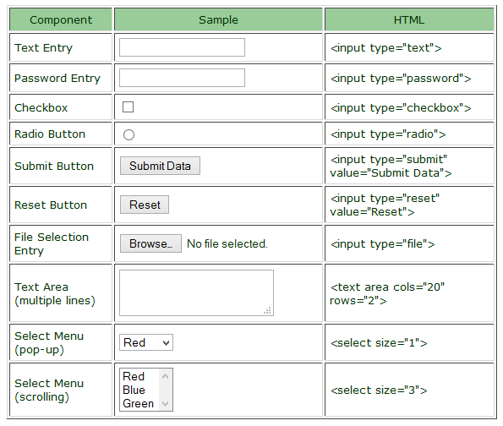
The Sender
Some of the objects are:

Slide 6
The Sender
GET | POST
Information sent from a form with the GET method is visible to everyone (all variable names and values are displayed in the URL). | Information sent from a form with the POST method is invisible to others (all names/values are embedded within the body of the HTTP request)
GET also has limits on the amount of information to send. But modern browsers have been extended the limit | It has no limits on the amount of information to send.
However, because the variables are displayed in the URL, it is possible to bookmark the page. This can be useful in some cases. | However, because the variables are not displayed in the URL, it is not possible to bookmark the page.
GET may be used for sending non-sensitive data. Note: GET should NEVER be used for sending passwords or other sensitive information! | Moreover POST supports advanced functionality such as support for multi-part binary input while uploading files to server.

Slide 7
The Catcher
The PHP superglobals $_GET and $_POST are used to collect form-data.
$_GET is an array of variables passed to the current script via the URL parameters.
$_POST is an array of variables passed to the current script via the HTTP POST method.

Slide 8
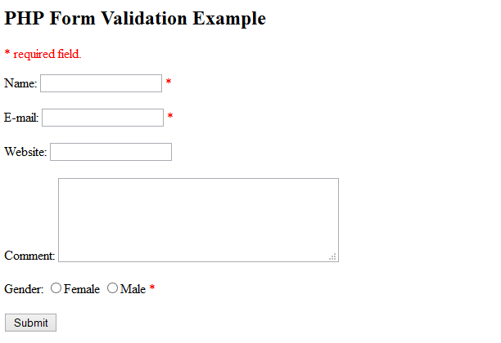
Try this one!
Try to make 2 pages of php.
The sender one will be like this.
The catcher one will catch the data and show all of them into the body.
Use both possibility sending method (GET and POST)
That’s it!
No more than 20 minutes!

Slide 9
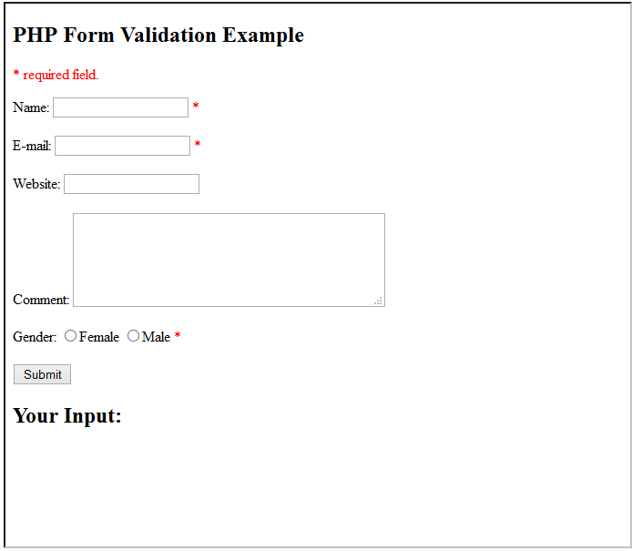
Try this one, too!
In this case, you don’t need the 2nd page.
The sender page also will be the catcher!
See “Your Input” section below?
That’s the area you can place any data that have been sent before.
It means that the area will be empty for the first time page loaded.
Hints: use isset() function to check if the $_POST exists or not

Slide 10
Try another one!
result-1
Sender: you need to send a required number (number 1-10)
Validator: catch the number sent. Compare it to a random number (1-10)
Jump to result-1 in case the numbers are match, otherwise jump to the result-2
Result-1: Hooray! You number <x> is correct
Result-2: Sorry! The number should be <x>
sender
validator
result-2

Slide 11
Hints the previous
Use header('Location: result1.php/?num=$num'); to jump from validator to result page
Use the query string to pass the number to result page

Slide 12
URL Encoding
URL encoding converts characters into a format that can be transmitted over the Internet.
URLs can only be sent over the Internet using the ASCII character-set.
URL encoding replaces unsafe ASCII characters with a "%" followed by two hexadecimal digits.
URLs cannot contain spaces. URL encoding normally replaces a space with a plus (+) sign or with %20.

Slide 13
URL Encoding
What are they?
http://www.w3schools.com/tags/ref_urlencode.asp

Slide 14
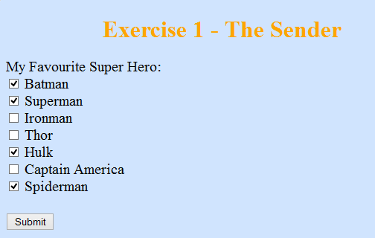
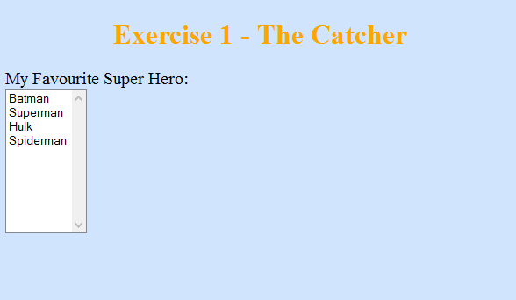
Exercise 1

Slide 15
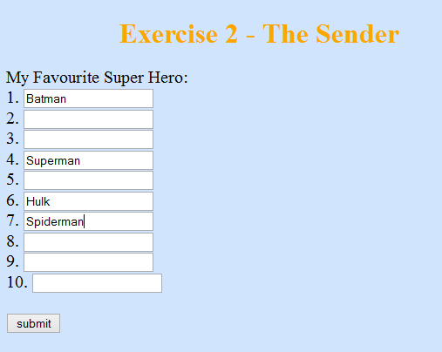
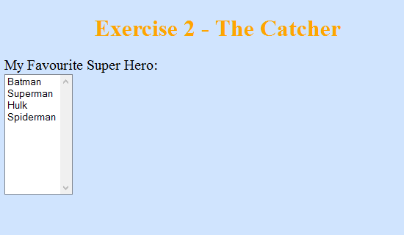
Exercise 2
Hints: the name of textbox object should be an array

